Slide 1
What is a model?
What purposes does a model serve?
What qualities does a model have?
What properties are desirable for models?

Slide 3
“
The essential purpose of cognitive modeling is to allow investigation of the implications of ideas, beyond the limits of human thinking. Models allow the exploration of the implications of ideas that cannot be fully explored by thought alone. As such, they are vehicles for scientific discovery, in much the same way as experiments on human (or other) participants. But the discoveries take a particular form: A system with a particular set of specified properties has another set of properties that arise from those in the specified set as consequences. From observations of this type, we then attempt to draw implications for the nature of human cognition. Alas, such inferences are under-constrained, and there is often room for differences of opinion concerning the meaning of the outcome of a given investigation. The implication of this is not that models are useless, but that care in interpreting their successes and failures, as well as further investigation, is usually required. This makes modeling an ongoing process, just like other aspects of science.
— Jay McClelland

Slide 4
“
The essential purpose of cognitive modeling is to allow investigation of the implications of ideas, beyond the limits of human thinking. Models allow the exploration of the implications of ideas that cannot be fully explored by thought alone. As such, they are vehicles for scientific discovery, in much the same way as experiments on human (or other) participants. But the discoveries take a particular form: A system with a particular set of specified properties has another set of properties that arise from those in the specified set as consequences. From observations of this type, we then attempt to draw implications for the nature of human cognition. Alas, such inferences are under-constrained, and there is often room for differences of opinion concerning the meaning of the outcome of a given investigation. The implication of this is not that models are useless, but that care in interpreting their successes and failures, as well as further investigation, is usually required. This makes modeling an ongoing process, just like other aspects of science.
— Jay McClelland

Slide 5
“
The essential purpose of cognitive modeling is to allow investigation of the implications of ideas, beyond the limits of human thinking. Models allow the exploration of the implications of ideas that cannot be fully explored by thought alone. As such, they are vehicles for scientific discovery, in much the same way as experiments on human (or other) participants. But the discoveries take a particular form: A system with a particular set of specified properties has another set of properties that arise from those in the specified set as consequences. From observations of this type, we then attempt to draw implications for the nature of human cognition. Alas, such inferences are under-constrained, and there is often room for differences of opinion concerning the meaning of the outcome of a given investigation. The implication of this is not that models are useless, but that care in interpreting their successes and failures, as well as further investigation, is usually required. This makes modeling an ongoing process, just like other aspects of science.
— Jay McClelland

Slide 6
“
The essential purpose of cognitive modeling is to allow investigation of the implications of ideas, beyond the limits of human thinking. Models allow the exploration of the implications of ideas that cannot be fully explored by thought alone. As such, they are vehicles for scientific discovery, in much the same way as experiments on human (or other) participants. But the discoveries take a particular form: A system with a particular set of specified properties has another set of properties that arise from those in the specified set as consequences. From observations of this type, we then attempt to draw implications for the nature of human cognition. Alas, such inferences are under-constrained, and there is often room for differences of opinion concerning the meaning of the outcome of a given investigation. The implication of this is not that models are useless, but that care in interpreting their successes and failures, as well as further investigation, is usually required. This makes modeling an ongoing process, just like other aspects of science.
— Jay McClelland

Slide 8
data & experiments
theory & models

Slide 9
a
b
What would happen if…?
c
d
data & experiments
theory & models

Slide 10
data & experiments
theory & models
a
b
Which model best explains…?
c
d

Slide 11
data & experiments
theory & models

Slide 13
What are computational cognitive models?

Slide 14
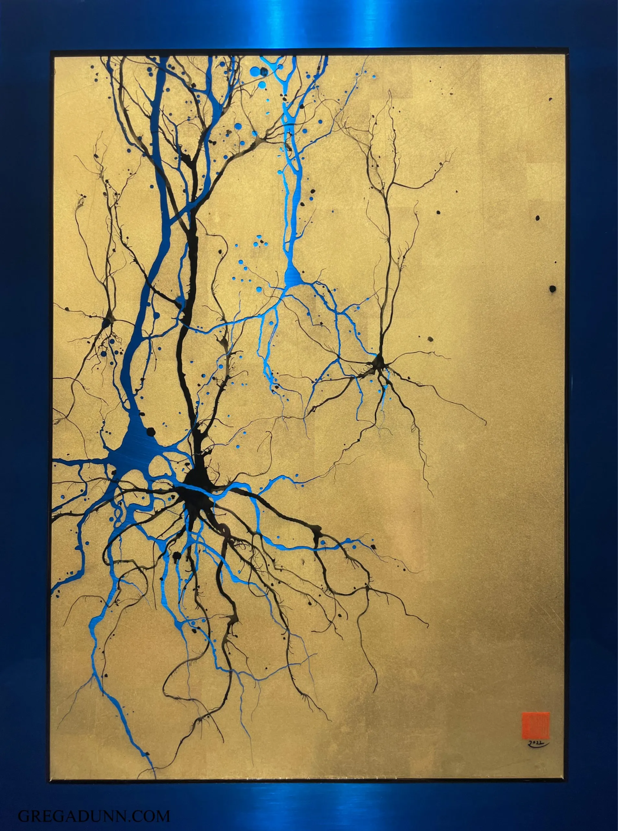
What kind of thing is a mind?

Slide 15

Adapted from Shimon Edelmann

Slide 16
kid
ball
adult
adult
dog
Adapted from Shimon Edelmann

Slide 17
What kind of thing is a mind?

Slide 18
It's not what it is made of.
It's what it does, and how it relates to the world.
What kind of thing is a mind?

Slide 19
It's not what it is made of.
It's what it does, and how it relates to the world.
What kind of thing is a mind?
How do we describe these functions and relationships?

Slide 20
We can use the language of computation.
Theory of computation gives us a rich set of formal tools to think about processes (aka algorithms!) and how they work.

Slide 21
what computational problem is being solved?
what computational processes are used?
how is the process implemented?

Slide 22
This semester
Neural networks from 1943 → 2025.
How has the development of neural network models over the past 80 years influenced how we think about the mind?

Slide 23
Course structure
Tuesdays we will typically look at a new technique or model type.
Thursdays we will typically discuss a paper that uses that technique.
Fridays we will have a lab for hands-on work, typically building the model from Thursday's paper.

Slide 24
Assignments
Weekly labs are 55% of grade. These are skill building activities, not evaluations of your ability to code.
Course project is 30% of your grade.
Participation is 15% of your grade.

Slide 25
Fill out pre-course survey on Moodle.
Sign up for a free Google Colab Pro account. Link on Moodle.

